Slide 1
Clarinda Board presentation: a financial review and 5-year outlook
Lora Appenzeller
January 19th, 2022

Slide 3
Enrollment

Slide 4
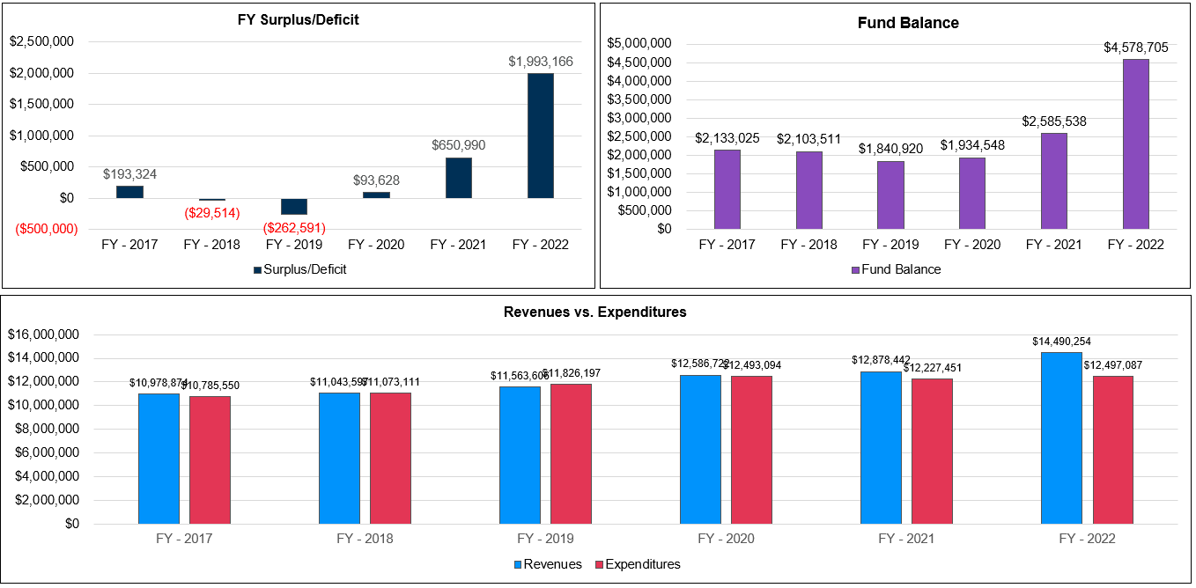
5-year Historical look at General Fund

Slide 5
5-year Historical look at General Fund

Slide 6
5-year Projection look at General Fund

Slide 7
Miscellaneous Revenue in General Fund

Slide 8
Key Assumptions in General Fund

Slide 9
Key Assumptions in General Fund
Assumptions used in the projections
SSA @2.5% for FY23 and then 2%
No staffing changes
No changes to enrollment
Keep tax rate the same- need to discuss ability to add PPEL levy without raising taxes in a future year
ESSER Revenue account for in FY22 and then completely spent in FY23. No ESSER $$ allocated to ongoing personnel costs
Salary increase set at 3%

Slide 10
Key Assumptions in General Fund

Slide 11
Key Results in General Fund

Slide 12
Key Results in General Fund

Slide 13
Key Results in General Fund

Slide 14
Key Results in General Fund

Slide 15
Unspent Authorized Budget Report

Slide 16
Unspent Authorized Budget Report

Slide 17
Solvency & Cash Reserve

Slide 18
Tax Rate

Slide 19
Three Important Projections for FY22

Slide 20
Three Important Projections for FY22

Slide 21
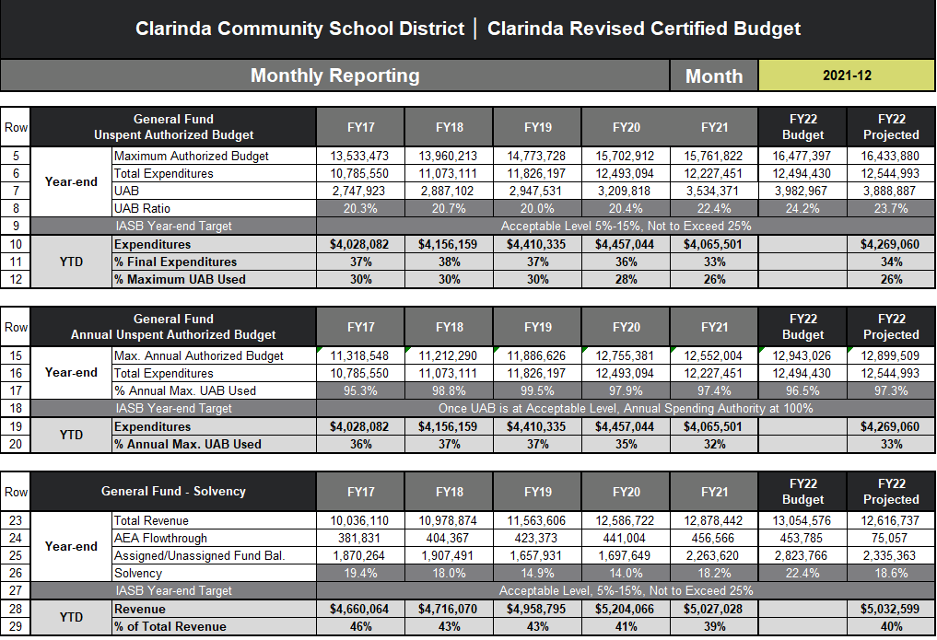

Slide 25
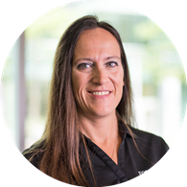
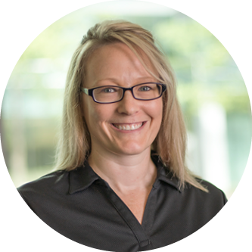
Questions? Contact Us:
Lora Appenzeller
Senior Advisor, Analytics
lappenzeller@forecast5analytics.com
515.518.6032
Shannon Duus
Advisor, Analytics
sduus@forecast5analytics.com
515.518.6033

Slide 26
Analytics Solutions For K-12 Education
Develop budgets, create projections, and model scenarios
Analyze data to quickly generate new perspectives on organizational performance.
Connect student data sets for insights, reporting, and custom dashboards.
Add a geovisual perspective to make more informed decisions.

